Slide 1

Loan Credit Bank Gilang Arito
Blank-space Academi Week 2

Slide 2

Mission statement:
To present insight to the loan manager about parameters that are affecting the loan credit default.

Slide 3
The problem
To minimize loss, banks need to be able to create approval decisions to determine customers who will default if given a loan, and who will keep paying.
An applicant’s demographic, socio-economic profiles, and past behaviors are considered by loan managers before a decision is taken regarding his/her loan application.

Slide 4
Business Questions
1. What Parameters are affecting the loan credit default? Is there any parameter that affects the default process the most (or no parameter at all)?
2. Is the available data and parameters enough to know what is affecting the credit default or not?

Slide 5


Credit Data
22 Features
1000 Applicants

Slide 6

The insight
Type of Parameters Affect Loan Credit Default
The Most Parameter Affect the Loan Credit Default

Slide 7
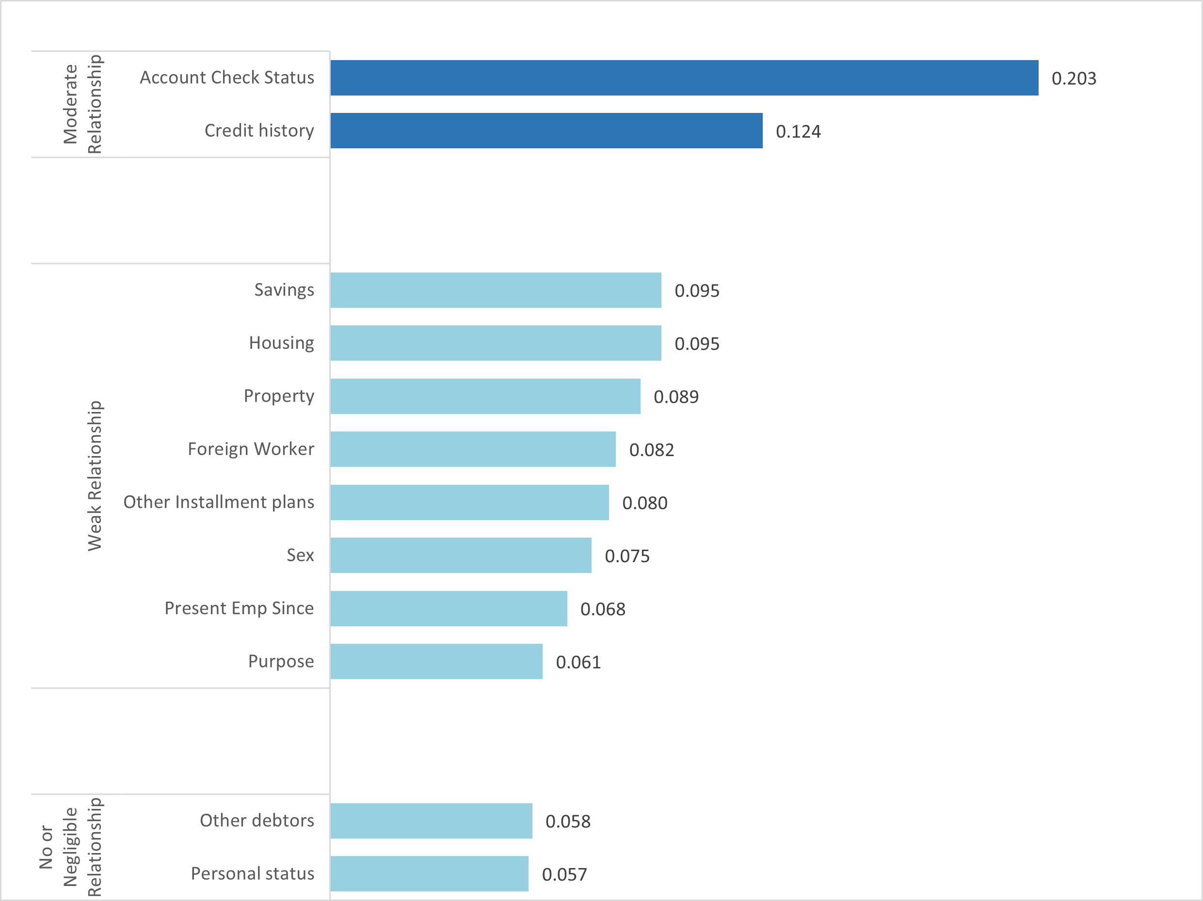
Categorical Parameters: The loan credit default varies greatly by parameters that affect it
Account Check Status & Credit History is the parameter that affects the default process most

Slide 8
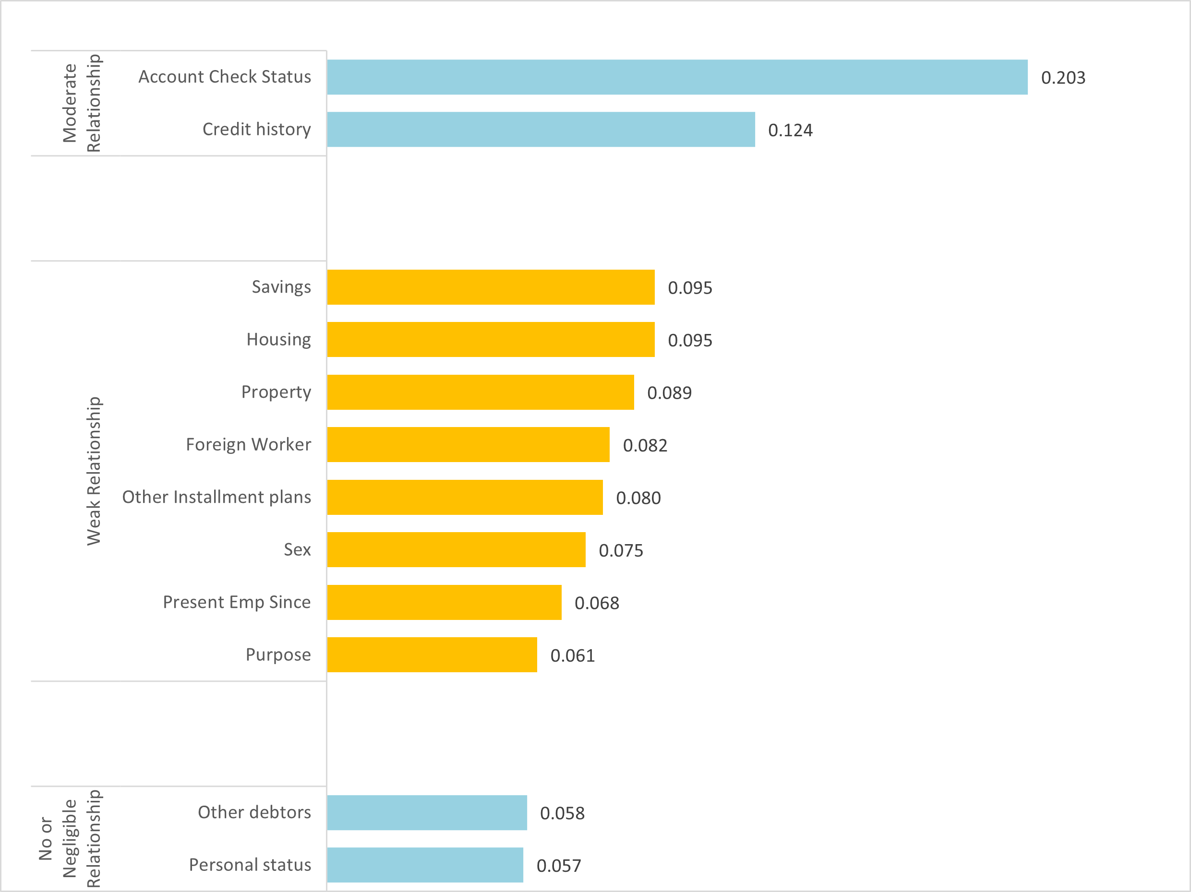
Categorical Parameters: The loan credit default varies greatly by parameters that affect it
The weak relationship category has the greatest number of parameters in a relationship category (8 parameters)

Slide 9
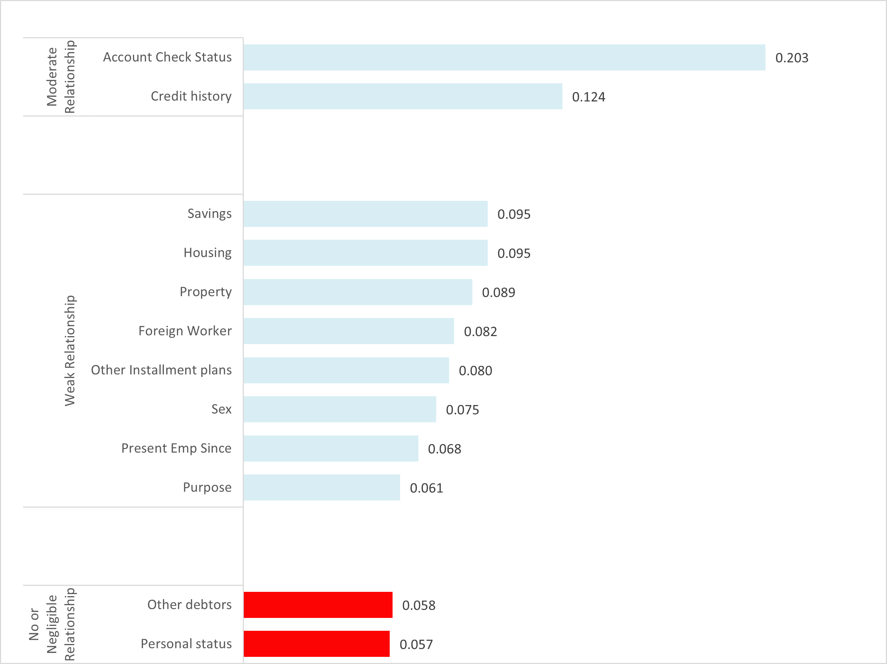
Categorical Parameters: The loan credit default varies greatly by parameters that affect it
Personal Status & Other Debtors is the least affects the default process. Will this parameter be preserved or deleted?

Slide 10
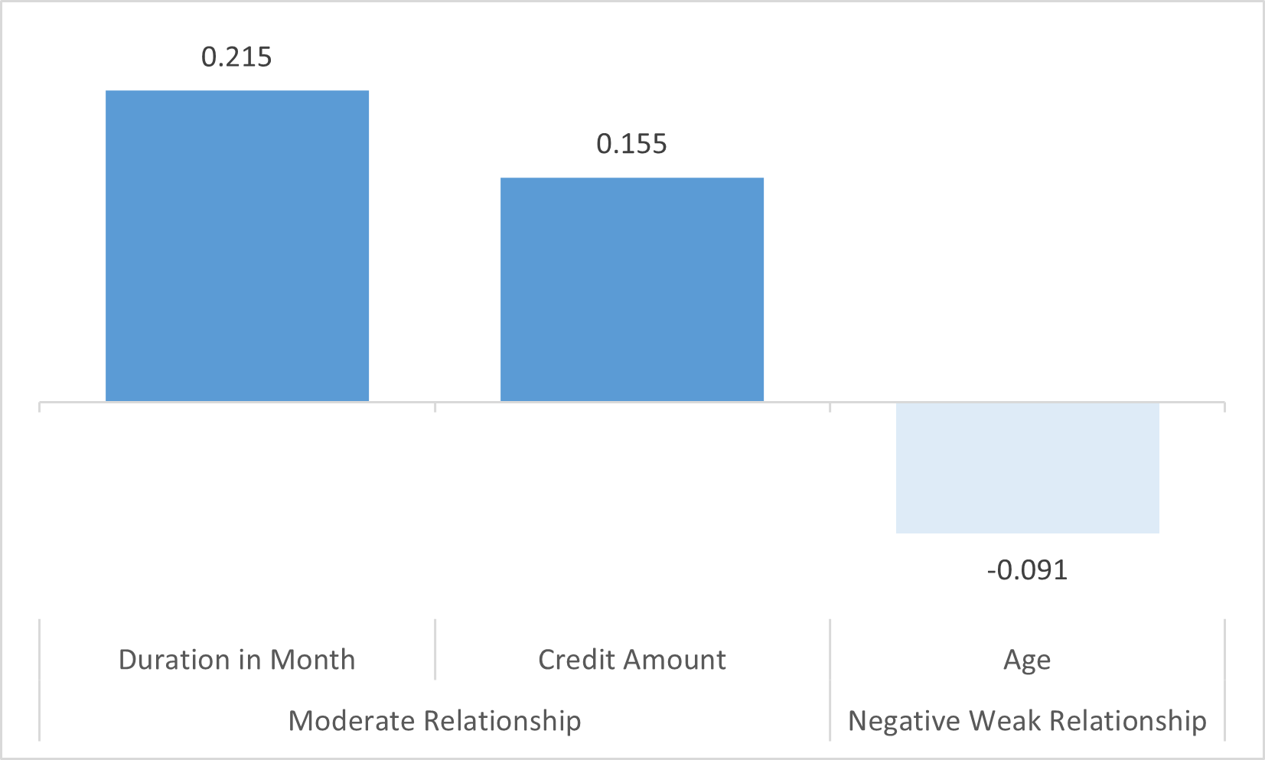
Numerical Parameters: The loan credit default varies greatly by parameters that affect it
Duration in Month & Credit Amount is the parameter that affects the default process most

Slide 11
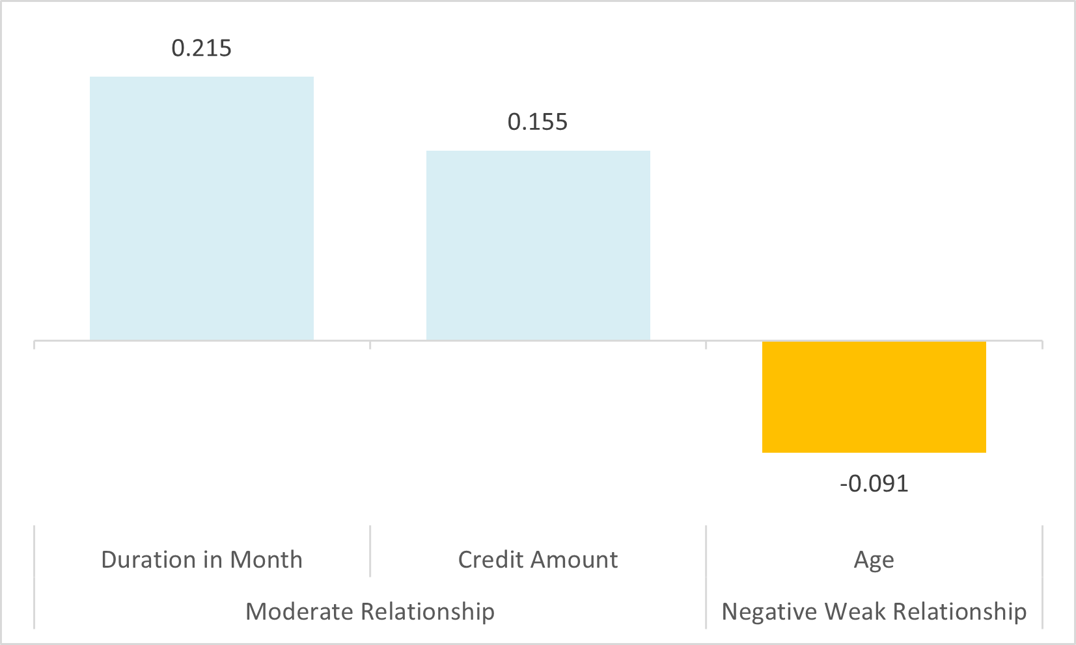
Numerical Parameters: The loan credit default varies greatly by parameters that affect it
Personal Status & Other Debtors is the least affects the default process

Slide 12
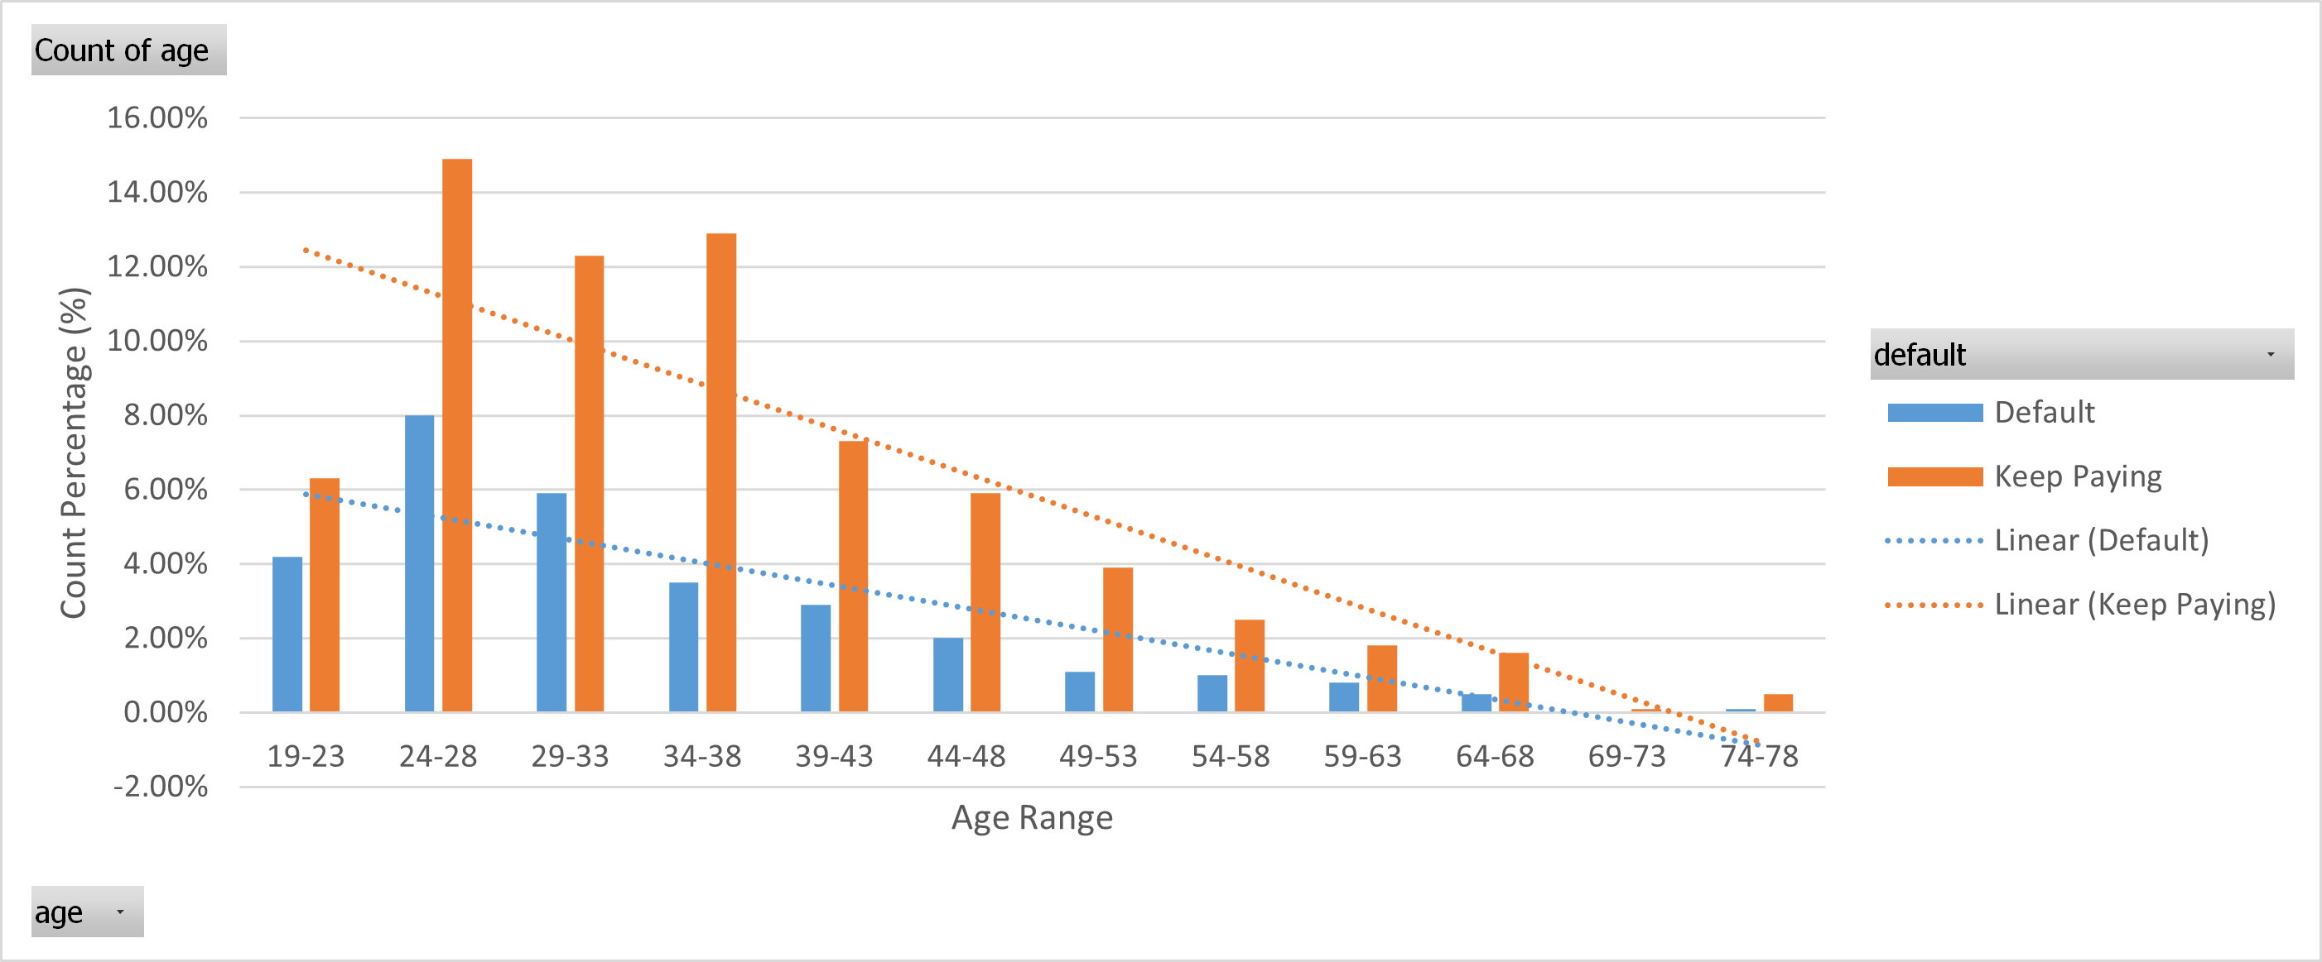
Age Parameter have a negative weak relationship toward credit default process

Slide 13
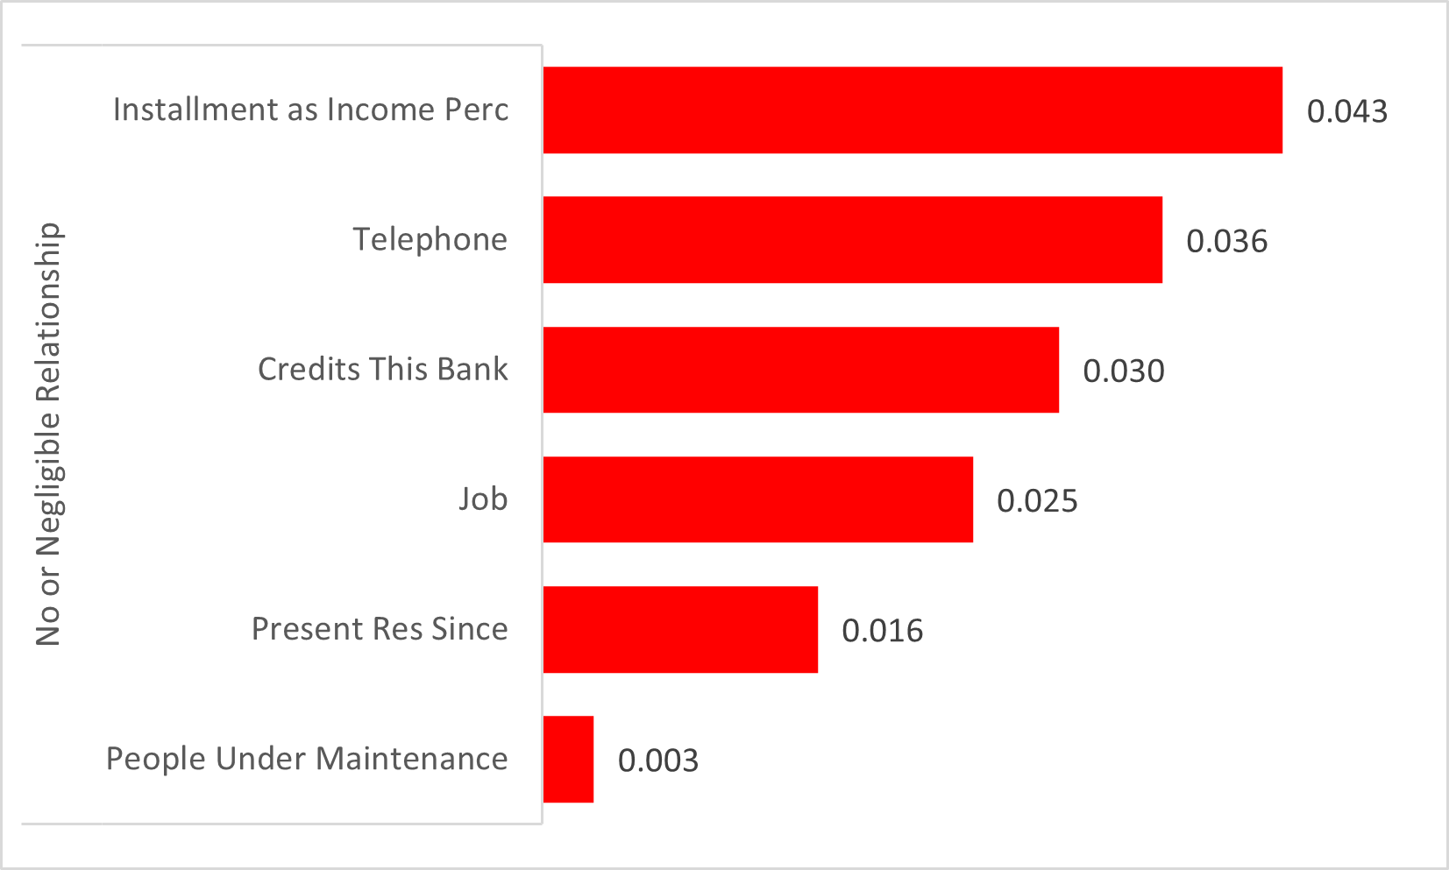
Categorical Parameters: Parameter that is not affecting the loan credit default
6 parameters don’t affect the default process

Slide 14
Is the available data and parameters enough to know what is affecting the credit default or not?
No, because the observed parameter does not have a strong correlation with the measured parameter (default parameter). So my suggestion is to get more applicant data.

Slide 15
Conclusion
12 categorical values affect the default process
3 numeric values affect the default process
Account Check Status & Credit History are the parameters that most influence the default process in categorical values.
On numeric values, Duration in Month & Credit Amount are the parameters that most influence the default process
We should get more data to know what is affecting the credit default or not

Slide 16
Thank You
Blank-space Academi Week 2

